Slide 1
Recommendation Systems

Slide 2
Market basket analysis
Discovers co-occurrence relationships among activities performed.
Market basket analysis can be used to divide customers into groups.
Market basket analysis may provide the retailer with information to understand the purchase behaviour of a buyer.
“customers who bought book A also bought book B”

Slide 3
Market Basket Analysis
For example:
When one super market chain discovered in its analysis that male customers that bought diapers often bought beer as well, have put the diapers close to beer coolers, and their sales increased dramatically.
Might tell a retailer that customers often purchase shampoo and conditioner together, so putting both items on promotion at the same time would not create a significant increase in revenue, while a promotion involving just one of the items would likely drive sales of the other.

Slide 4
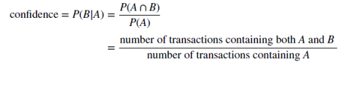
Support and Confidence
The support s for a particular association rule A => B is the proportion of transactions in that contain both A and B. That is,
The confidence c of the association rule A => B is a measure of the accuracy of the rule, as determined by the percentage of transactions in D containing A that also contain B. In other words,

Slide 5
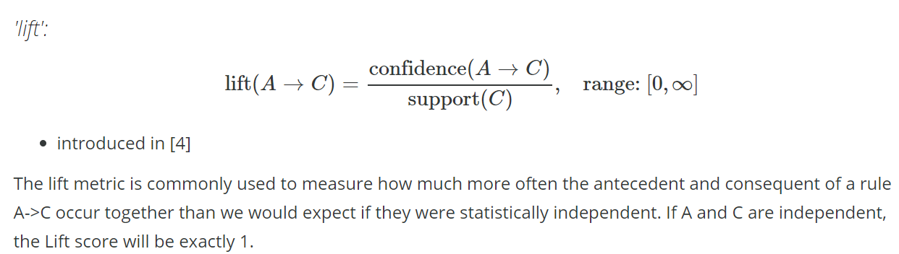
Lift
http://rasbt.github.io/mlxtend/user_guide/frequent_patterns/association_rules/

Slide 6
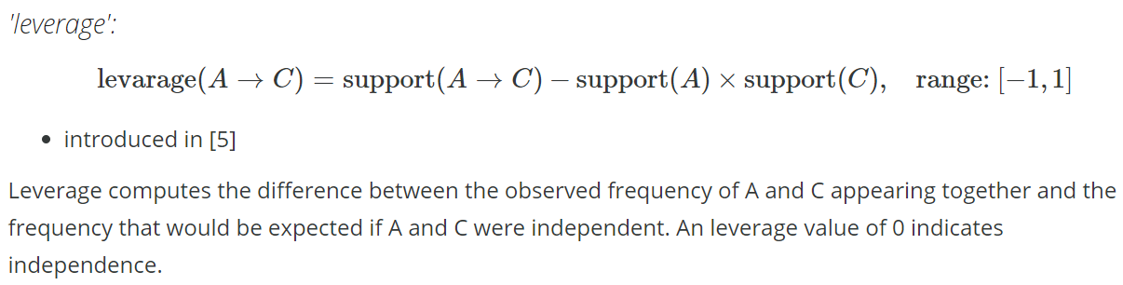
Leverage
http://rasbt.github.io/mlxtend/user_guide/frequent_patterns/association_rules/

Slide 7
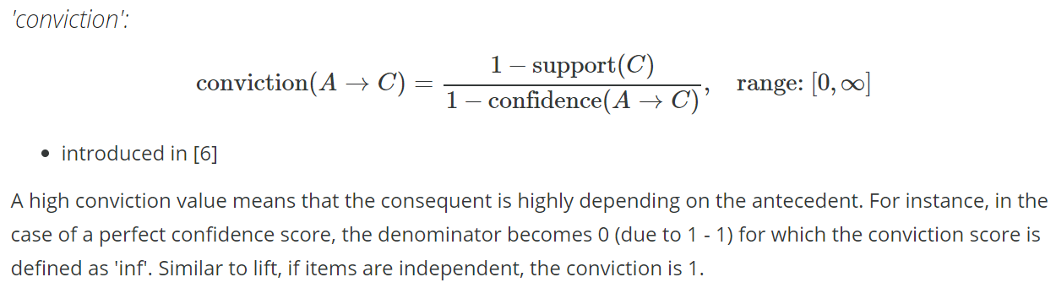
Conviction
http://rasbt.github.io/mlxtend/user_guide/frequent_patterns/association_rules/

Slide 8
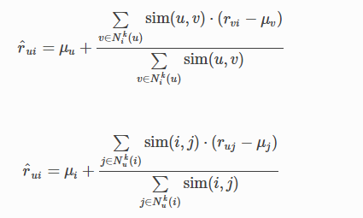
Mean centering the ratings
Ratings can be centered around the mean to address individual biases in rating

Slide 9
IBCF vs UBCF
IBCF is more efficient than UBCF
Typical applications involve far more Users than Items. Hence Similarity matrix for IBCF is more compact than UBCF
Similarity estimates between items is also more likely to converge over time than similarity between users. Hence the similarities can be pre-computed and cached unlike similarity between users that need to be dynamically computed
However, the IBCF recommendations tend to be more conservative than UBCF

Slide 10
Strengths of Collaborative Filtering
Content-Agnostic
Collaborative filtering does not require items or users to be related with the content information
Unlike Popularity & content based recommendation systems, recommendations are very personalized
Adapts to the user
Adaptive to change in preferences of the users over time

Slide 11
Issues with collaborative filtering
Cold Start problem: The model requires enough amount of other users already in the system to find a good match.
Sparsity: If the user/ratings matrix is sparse, and it is not easy to find the users that have rated the same items.
Popularity Bias: Not possible to recommend items to users with unique tastes.
Popular items are recommended more to the users as more data being available on them
This may begin a positive feedback loop not allowing the model to recommend items with less popularity to the users
•Shilling attacks
Users can create fake preferences to push their own items
•Scalability
Collaborative filtering models are computationally expensive

Slide 12
MATRIX FACTORIZATION BASED APPROACH

Slide 13
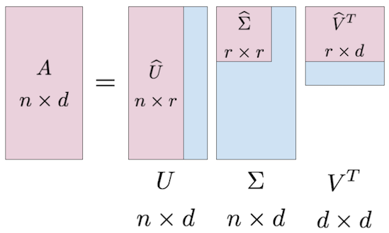
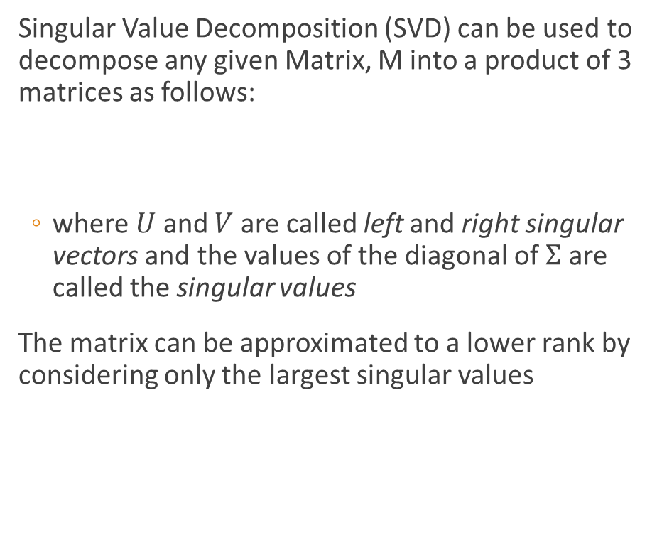
What is Singular Value Decomposition (SVD)
Singular Value Decomposition (SVD) can be used to decompose any given Matrix, M into a product of 3 matrices as follows:
where $U$ and $V$ are called left and right singular vectors and the values of the diagonal of $Σ$ are called the singular values
The matrix can be approximated to a lower rank by considering only the largest singular values

Slide 14
SVD for User Item Matrix
SVD on the User Item Matrix can help generate 2 lower rank matrices – A User-Feature Matrix and an Item Feature Matrix
Intuitively, the features may represent some underlying themes/latent factors. Eg in the case of movies the features may broadly represent different genres, high budget/low budget movies, commercial/art films etc

Slide 15

Funk SVD approach
User Item matrix is highly sparse, hence traditional SVD algorithms cannot be used to factorize the matrix
Hence, User features and Item features are determined by optimizing the following cost function:
Where,
p_{u} and q_{i} are the features vectors for User u and item i respectively
lambda is the regularization parameter
The cost function can be optimized using Gradient Descent

Slide 16

Generating Predictions using SVD
The vector pu represents the affinity of user u for each of the latent factors
Similarly the vector qi represents affinity of the item i for the latent factors
Hence, to estimate the preference of user u towards rating I we can simply multiply the feature vectors together
To estimate the rating for each pair of User/Item we can simply take the dot product of User-Feature and Feature-Item Matrix

Slide 17
Content based Recommendation

Slide 18
Content Based Recommendation
Advantages
Content-based recommender systems do not use a lot of user data.
Only requires item data and you can start giving recommendations to users.
No Cold start problem - Content based recommendation system does not depend on lots of user data, so it is viable to give recommendations to even your first customer as long as you have sufficient data to build his user profile.
Cheaper to build and maintain
Challenges
The item data needs to be well distributed
Recommendations to the user will be mostly substitutes, and not complements.
Less dynamic

Slide 19
Bag of Words (BoW) vectorization
Text data cannot be directly used for Modelling
One approach to extract features involves the Bag of Words (BoW) approach
The BoW approach generates a Document-Term Matrix (DTM) where columns represents all the unique words in the corpus and the cell value indicates the frequency of that word in a given document (represented by rows)
Raw Text | movie | great | loved | amazing | action | scenes | boring | hated | bored | really | acting | plot
This movie is great | 1 | 1
loved the movie | 1 |  | 1
Amazing action scenes. Great movie |  |  |  | 1 | 1 | 1
movie is boring | 1 |  |  |  |  |  | 1
boring movie. Hated it | 1 |  |  |  |  |  | 1 | 1
loved the acting and the plot |  |  | 1 |  |  |  |  |  |  |  | 1 | 1
got really bored with the movie | 1 |  |  |  |  |  |  |  | 1 | 1

Slide 20
Enhancements to simple BOW approach
The Document Term Matrix can be further enhanced by:
Removing stop words (such as “the”, “and” etc..)
Removing very sparse or very common words from the corpus
Reducing variations in word forms using Lemmatization or Stemming (e.g. boring and bored show up as 2 separate columns in the example before)
Including n-grams to capture common phrases (e.g Machine Learning is a single phrase)
TF-IDF to capture relative importance of words in a document

Slide 21
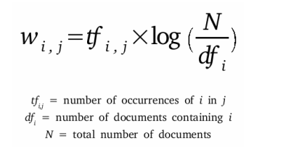
TF-IDF
TF-IDF is composed of 2 terms:
Term Frequency (TF) measures how frequently a term appears in the document
Inverse Document Frequency (IDF) measures the relative importance of words in a corpus. Hence commonly appearing words would have a low IDF score whereas rarer words (which are potentially more informative) would have a higher IDF score

Slide 22
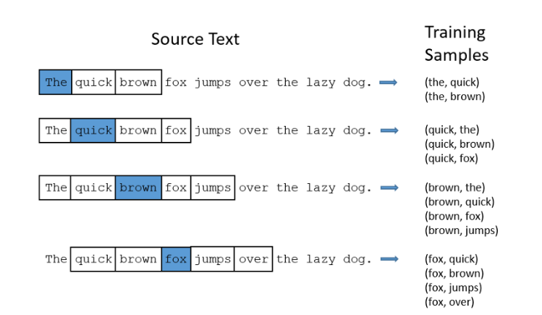
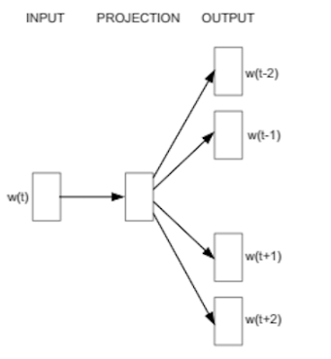
Word Embedding Models (Word2Vec)
Word vectors are trained by setting up a fake training task
For e.g. in the Skip gram architecture, the model tried to predict the neighboring/surrounding words given the target word
The weights of the hidden layer learnt during the training process provides the feature vector for each word – Words that appear in similar context ends up having similar feature vectors
http://mccormickml.com/2016/04/19/word2vec-tutorial-the-skip-gram-model/

Slide 23
Methods of Hybridization
Some of the typical methods of Hybridization include
Weighted–Recommendations from each system is weighted to calculate final recommendation
Switching–System switches between different recommendation model
Mixed-Recommendations from different recommenders are presented together.
A common approach is to use Latent Factor models for high level recommendation and then improving them using content based systems by using information on users or items

Slide 24
Hybrid recommender systems
Multiple recommender systems are combined to improve recommendations.
Although any type of recommender systems can be combined a common approach in industry is to combine content based approaches and collaborative filtering approaches.
Content based models can be used to solve the Cold start and Grey Sheep problems in Collaborative filtering.

Slide 25
THANKS!

